Slide 1
Sentiment Analysis of Big Data from Internet News
Suvdeep Bagui
54, MIB, DSE

Slide 2
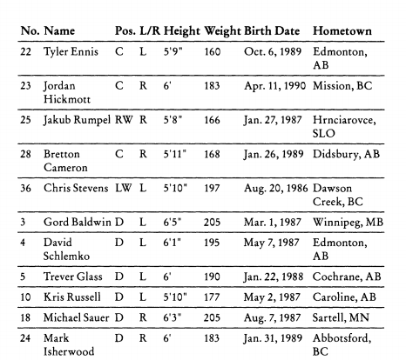
Data holds hidden Information

Slide 3
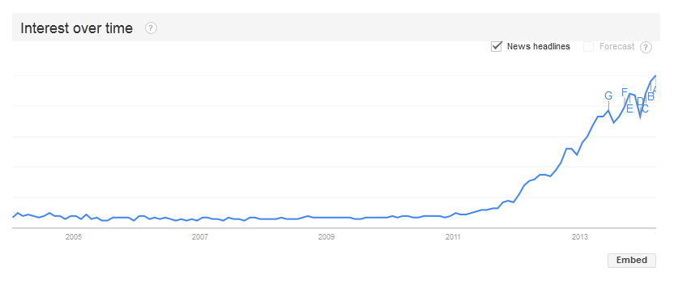
BIG DATA
Big Data refers to datasets whose size are beyond the ability of typical database software tools to capture, store, manage and analyses.
3Vs (volume, variety and velocity) are three defining properties of big data.

Slide 4
Objective of the Study
To find hidden trends, or patterns which may be invisible to the naked eye among all these news articles.
Does news about a particular country contain more or less opinionated /sentimental content than others?
Is there anything common in highly sentimental news?

Slide 5
Sentiment Analysis
Sentiment analysis (also known as opinion mining) refers to the use of natural language processing, text analysis and computational linguistics to identify and extract subjective information in source materials.
Classification of text into categories such as “positive”, “negative” and in some cases “neutral”.

Slide 6
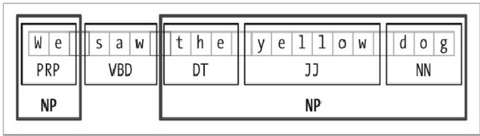
Python and NLTK
NLTK is a leading platform for building Python programs to work with human language data. It is a suite of libraries and programs for symbolic and statistical natural language processing.
Basic tasks include tokenization, stemming, POS tagging, chunking, parsing, etc.

Slide 7
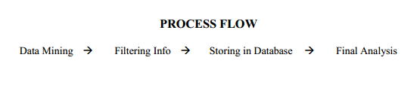
Research - Sample Data & Process Flow
USA - 200
China - 200
Russia - 200
Bangladesh - 200
Pakistan – 200
Articles from the Newspaper – THE HINDU

Slide 8
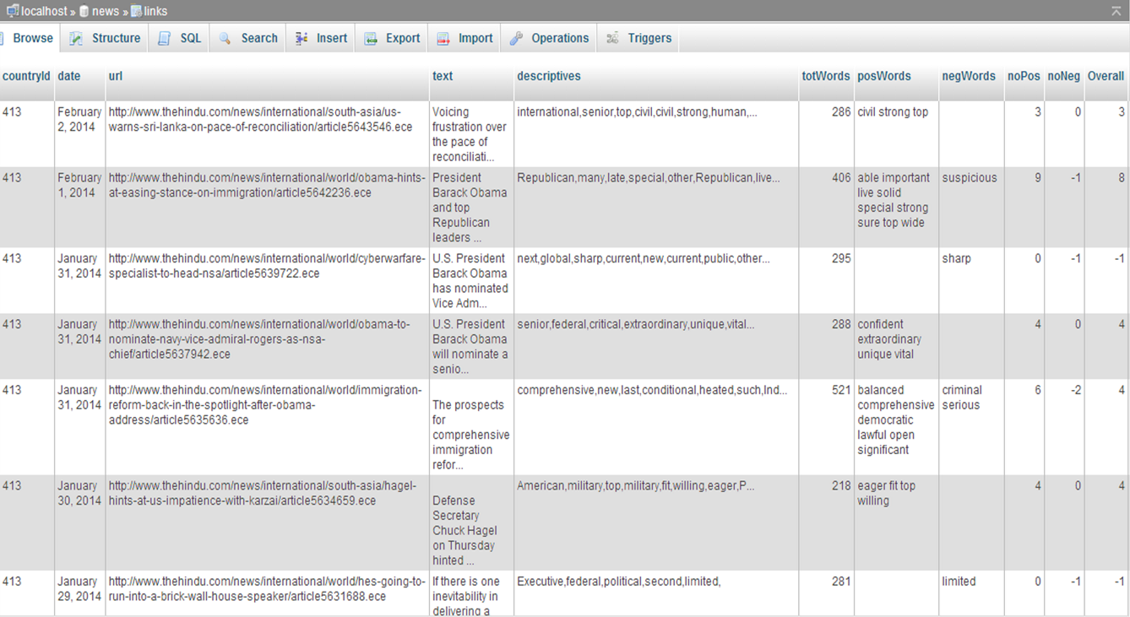

Slide 9
FINDINGS

Slide 10
Final Compiled Data
 | USA | Russia | China | Pakistan | Bangladesh
Total Word Count | 83214 | 79356 | 85596 | 81324 | 63264
Positive Score | 604 | 582 | 617 | 449 | 354
Negative Score | -319 | -282 | -314 | -295 | -272
Overall Score | 285 | 300 | 303 | 154 | 82

Slide 11
Observation 1: Although equal number of articles were compared for each county (200 countries, length of articles about Bangladesh appear to significantly shorter than others. China sees the longest articles of all the countries.)

Slide 12
Observation 2: Our neighboring countries, Bangladesh and Pakistan have much lower positive sentiment score than others. Also surprising is that Russia has the highest positive content density of all.

Slide 13
Observation 3: Russia has the least negative content density of all, while surprisingly US tops in absolute terms. Our neighboring countries Pakistan and Bangladesh have a lot of negative content in their articles, especially Bangladesh.

Slide 14
Observation 4: Overall sentiment of all the five countries is positive. However, Bangladesh and Pakistan lag considerably behind other three countries. Also, that China and Russia edge past USA, China having the highest Overall Sentiment Score.

Slide 15
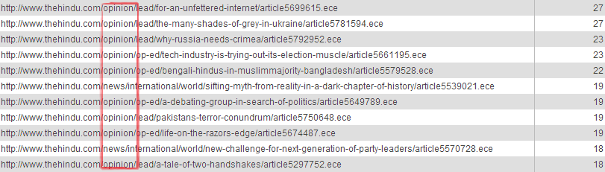
Observation 5: Articles containing highest sentimental words are mostly from Op-ed section.
Observation 6: Articles containing highest sentimental words are mostly about politics.

Slide 16
Limitations
Opinion lexicon used is far from sufficient for accurate sentiment analysis.
Most sentiment analysis algorithms use simple terms to express sentiment about a product or service. However, cultural factors, linguistic nuances and differing contexts make it extremely difficult to turn a string of written text into a simple pro or con sentiment.
Another method of generating sentiment lexicon is to make it specific to the research subject. This practice increases the accuracy.

Slide 17
Thank You

